Slide 1
WEB DEVELOPMENT AND DESIGN AT NAIK SOLUTION
NAME : PRATIK PRANAV
DEPARTMENT MENTOR NAME : Ms. Siddhi Naik

Slide 2
Technologies learned:
Full stack developer
Html | CSS | Javascript| pHp| MySql|WordPress | Figma | Manual Testing and other useful technical informations.
Softwares and hardwares used:
Sublime Text | Figma | Wordpress | Google Chrome Browser | Laptop.

Slide 3
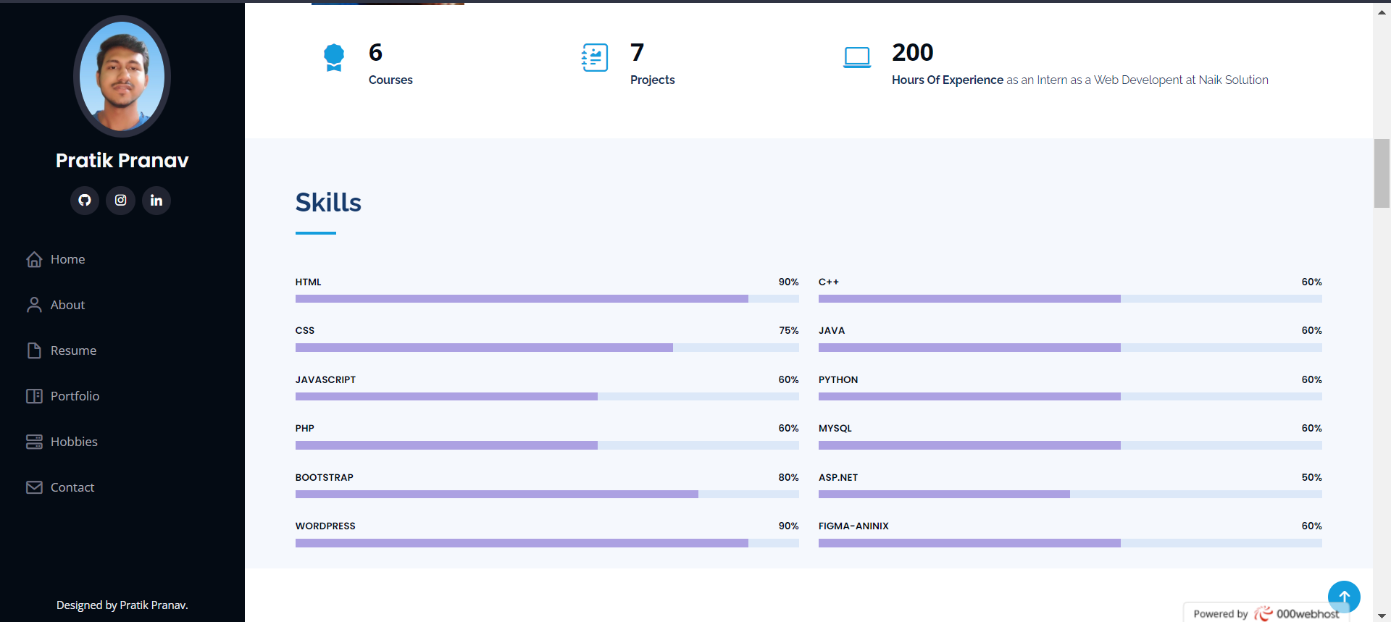
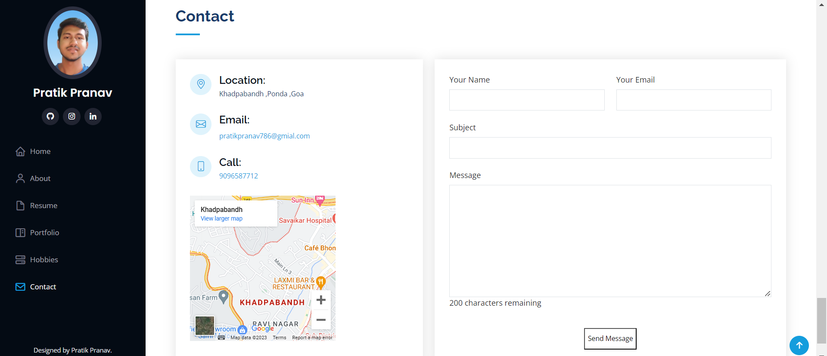
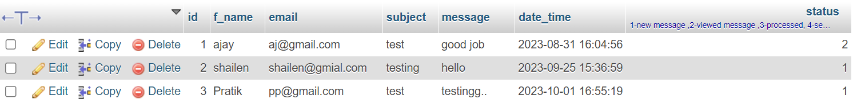
WORKS DONE :
1. Bootstrap Portfolio website –
( html | css |bootstrap | php pdo | mysql db )
Frontend validation using JS
Backend validation using php
Sending data using from frontend to backend.
JS message word counter
All other features of a Portfolio website.

Slide 4
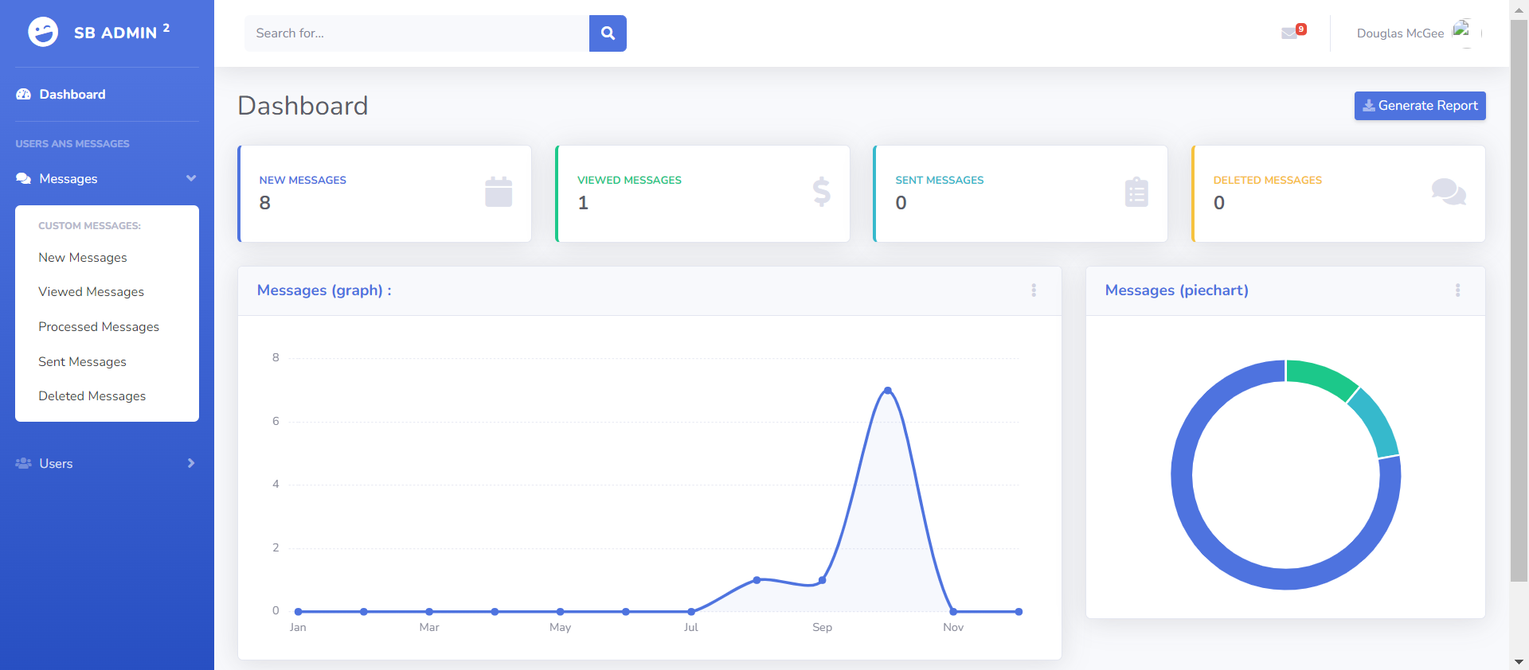
…
2. Admin Dashboard –
Login, Logout and Registration using sessions-
Validations and data transfers.
Data Retreival from Database .
Real time data updation in database from
admin dashboard.
php Mailer : sending real email to user using gmail.
Password encryption and Login : store encrypted password in db and match it with user typed to login.
Google reCAPTCHA V2 while Login.

Slide 5
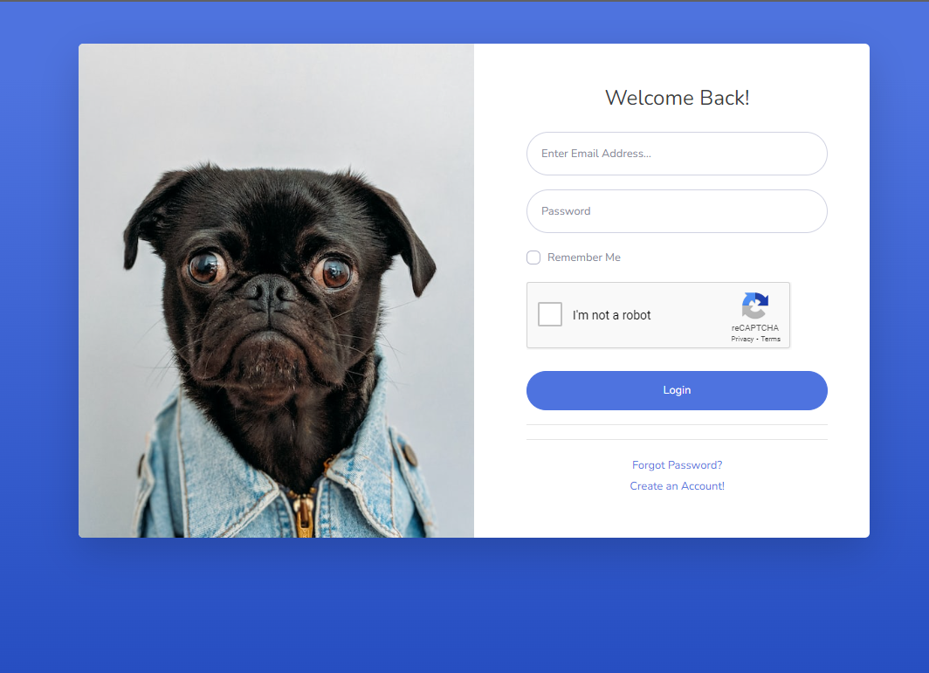
…
Message box in Admin Dashboard.
Retreive message from database and display in dropdown along with the time and the number of messages received .
Modified the existing Graph and Piechart -> Design the graph based on messages appeared in a particular month.
Photo upload in server and source link in database ( done in other site).
Login attempts and Lockout ( done in other site).
otp sending and verifying before login ( half complete )

Slide 6
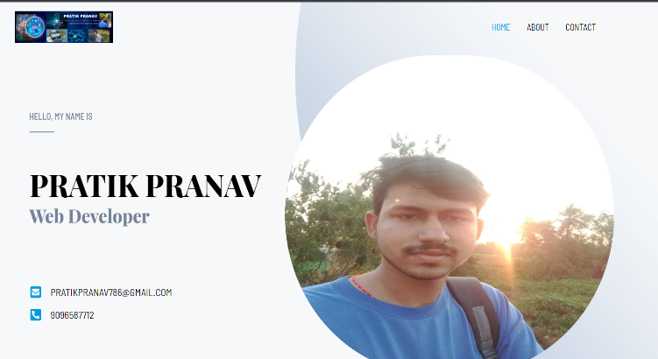
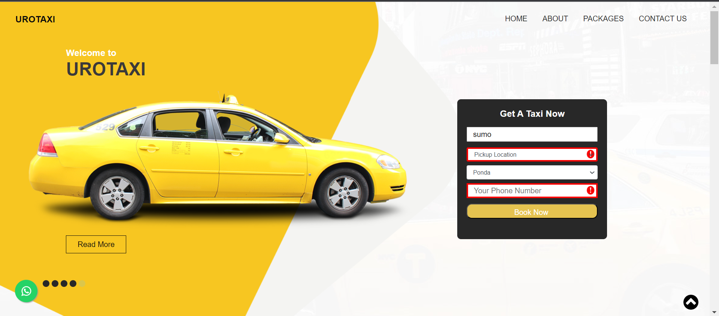
…
3. Wordpress Portfolio Website :
- used Astra Starter Template and edited with Elementor
- also used other plugins s.a wpforms and wp mail smtp
to send mails.
Got to know about wordpress (cms) and when to use it.
Counter (counting hours) | Progress bar | Gallery (portfolios)
Icon boxes ,lists and others, | Google maps |
And widgets and icons in header and footers.
4. Taxi template website:
whatsapp floating button and scroll top button on scroll
-error validations , packages tabs and images

Slide 7

…
5. Figma ( Aninix ) :
-Basics and developed animation logo for Naik Solutions
6. Php mpdf :
First designed a html page and then converted it into a pdf using php mpdf library.
Testing
Website Testing Report document for the website ngigoa.com -> sent to colleague for error checking.
Received Testing document from my colleague -> of the website -> vinaycom.com → did website testing and documented and sent back.
Learning about Domain name ,Hosting and other useful informations
BigRock → Linux Hosting | Cpanel | and various other details about hosting, packages and their needs.
AND OTHER TECHNICAL INFORMATIONS …………………….

Slide 8
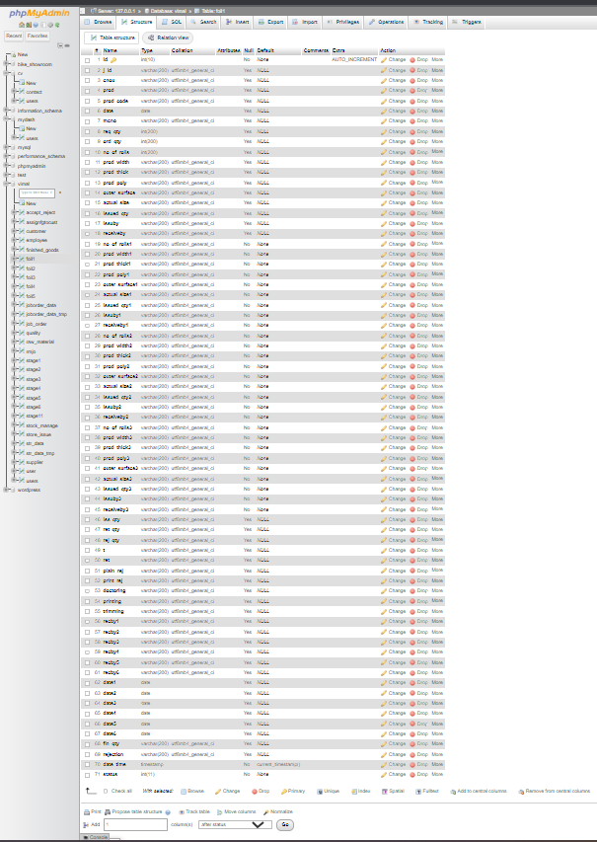
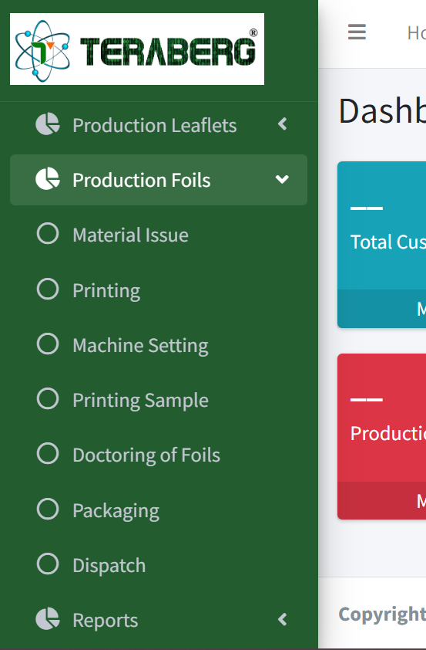
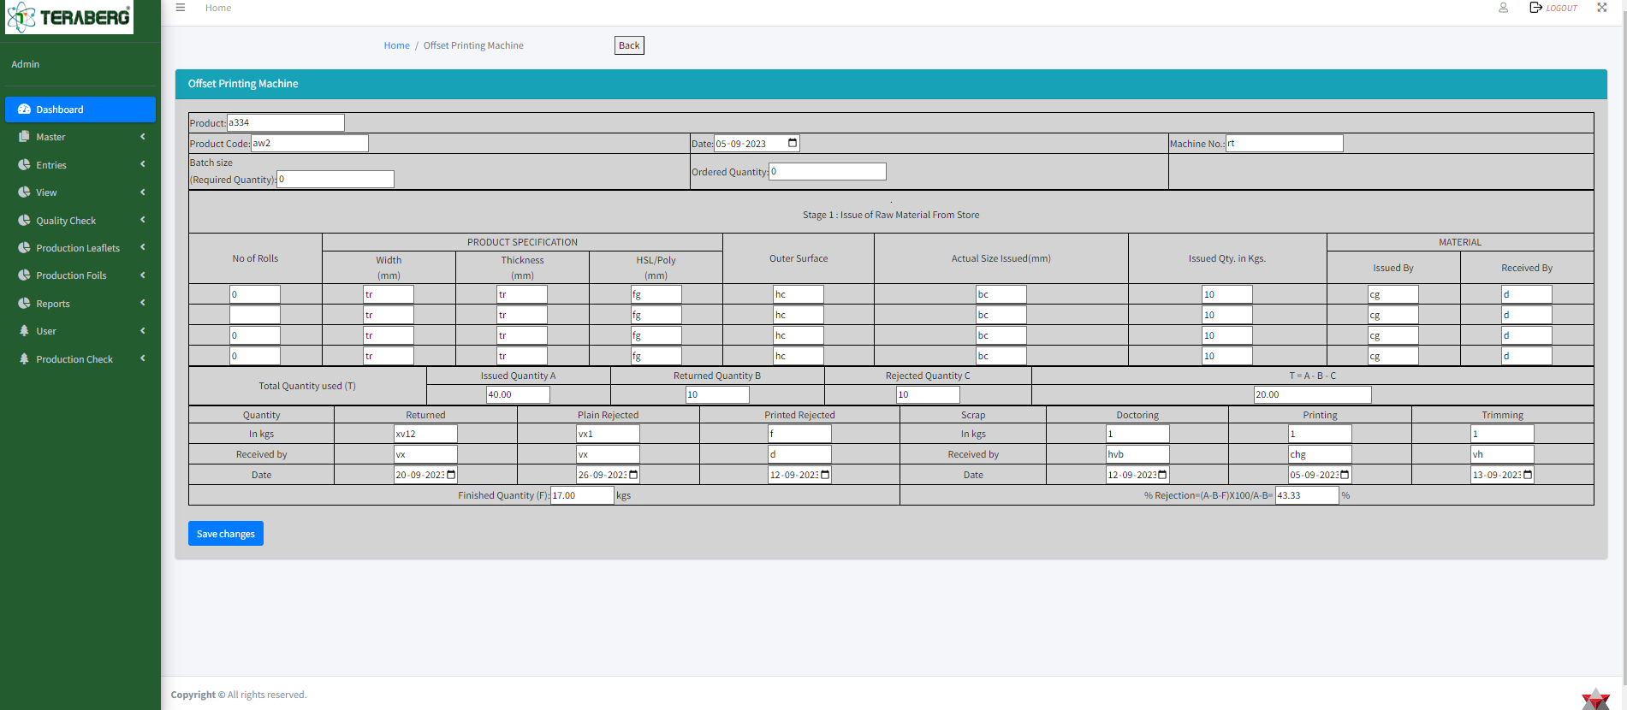
Live projects
1. Live Project ( Vimal pvt.ltd )
- Forms and Table design ( 7 pages )
-Validation for different forms.
Calculations and logics in tables and forms.
Database connection and data retreival

Slide 9
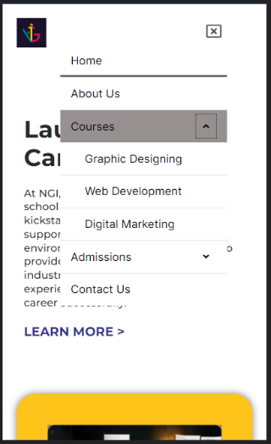

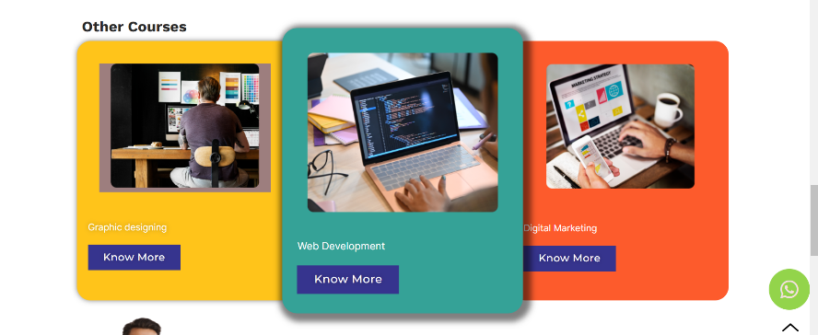
…
2. Live Project → WordPress → Net Global Institute → ngigoa.com
Home page | 3 Courses page and header and footer changes
Responsive website and various styles and effects.
whatsapp floating button. | custom css for scaling.
Google maps | use of Accordian.
* Responsive menus using header and footer builder plugin.

Slide 10
References:
[5] google.com
[1] Net global institute website.
[2] Figma – Aninix website : https://app.aninix.com/edit/lloyojkm1m61bwr6pyw
My portfolio website
My developed websites respectively.
Teraberg mis website (Admin dashboard)

Slide 11
Thank You

